Slide 1

Pneumonia Prediction
CodeGEeks

Slide 2



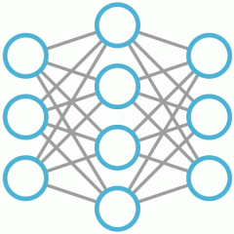




STEP 2
STEP 3
STEP 1
Pre-processing of the images are being done so that the neural network can work properly. We would do resizing, thresholding, grey scaling (converting to 0 or 1 rgb values)
Got Datasets from https://www.kaggle.com/datasets
It had classified datasets of pictures
Having pneumonia and not having the disease
Then we created neural network which would be a simple stacked CNN. We are still trying to find the most appropriate structure of the neural network through trail and error.
STEP 5
The trained model (model.h5) is then used by the website to predict whether the image is having pneumonia or not.
Developing the website
STEP 4

Slide 3

Training the Model

Slide 4
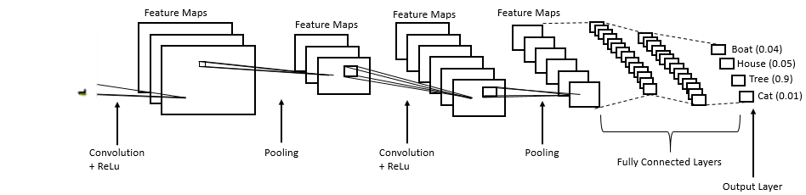
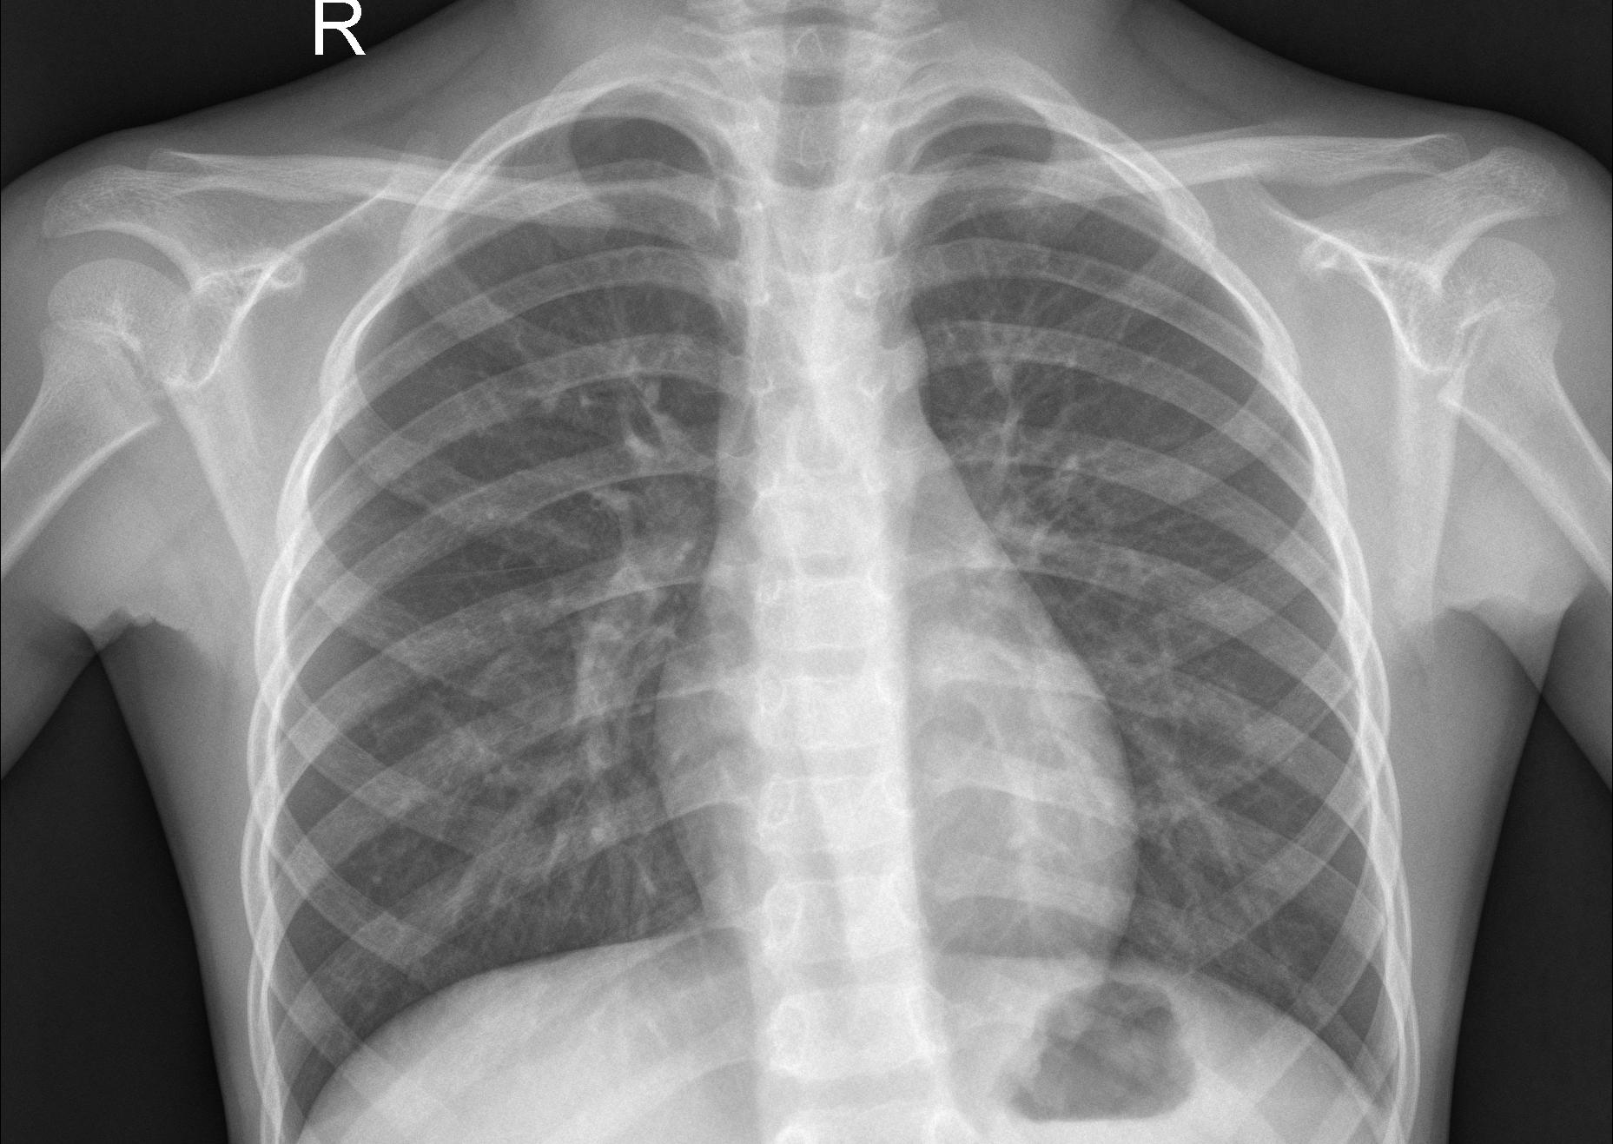
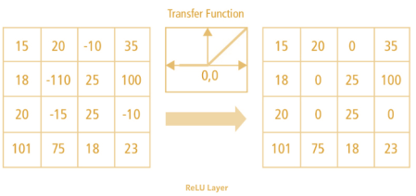
Feature Extraction
Classification-Fully Connected Layers
Pneumonia
Not Pneumonia
Kernel 3 * 3
Feature Map/Convoluted Feature
Feature Map
Passing through Relu
Image with zero padding

Slide 5
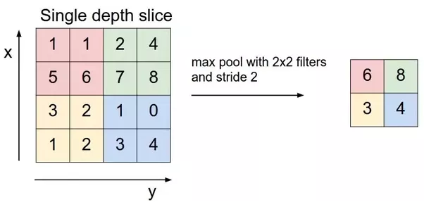
MaxPooling
Passing through Relu

Slide 6
